Slide 1

Time Series Analysis/ Forecasting

Slide 2
Applications of Forecasting
Demand Forecasting.
Inventory Management.
Hotel Bookings.
Passengers.
Stock Markets

Slide 3
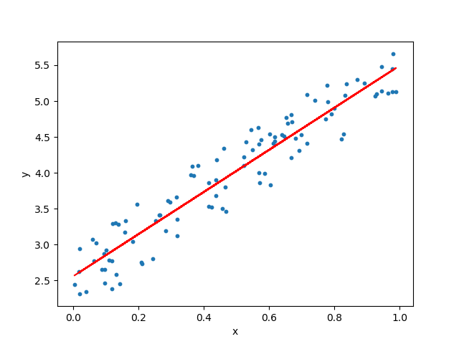
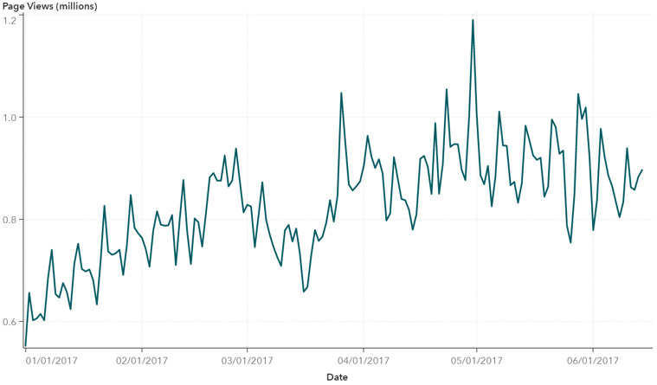
Regression v/s Time Series

Slide 4
Methods of Forecasting
1. Naïve Method
2. Simple Average
3. Moving Average
4. Exponential Smoothing
5. Holt Winters
6.ARIMA
7.Auto ARIMA

Slide 5
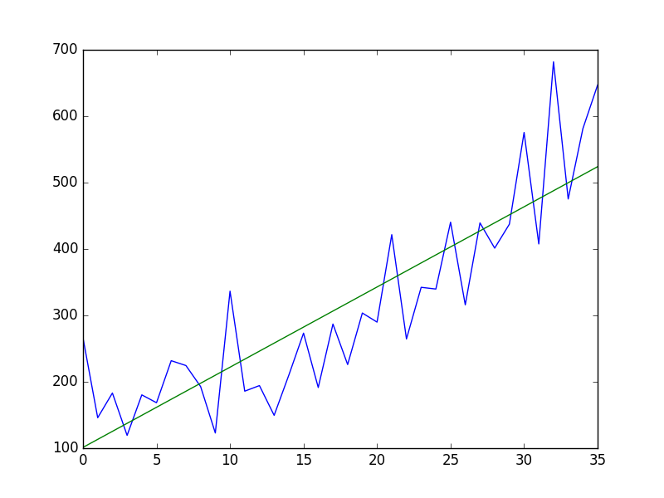
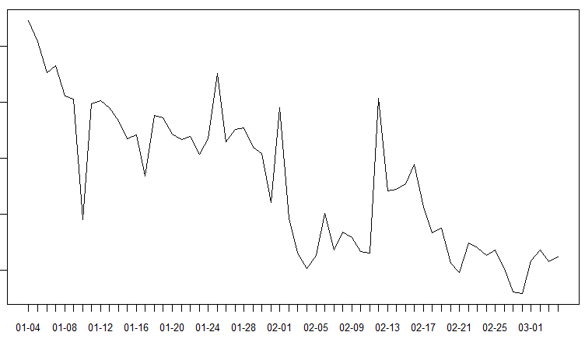
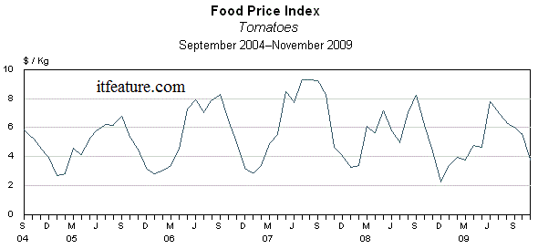
Trend

Slide 6
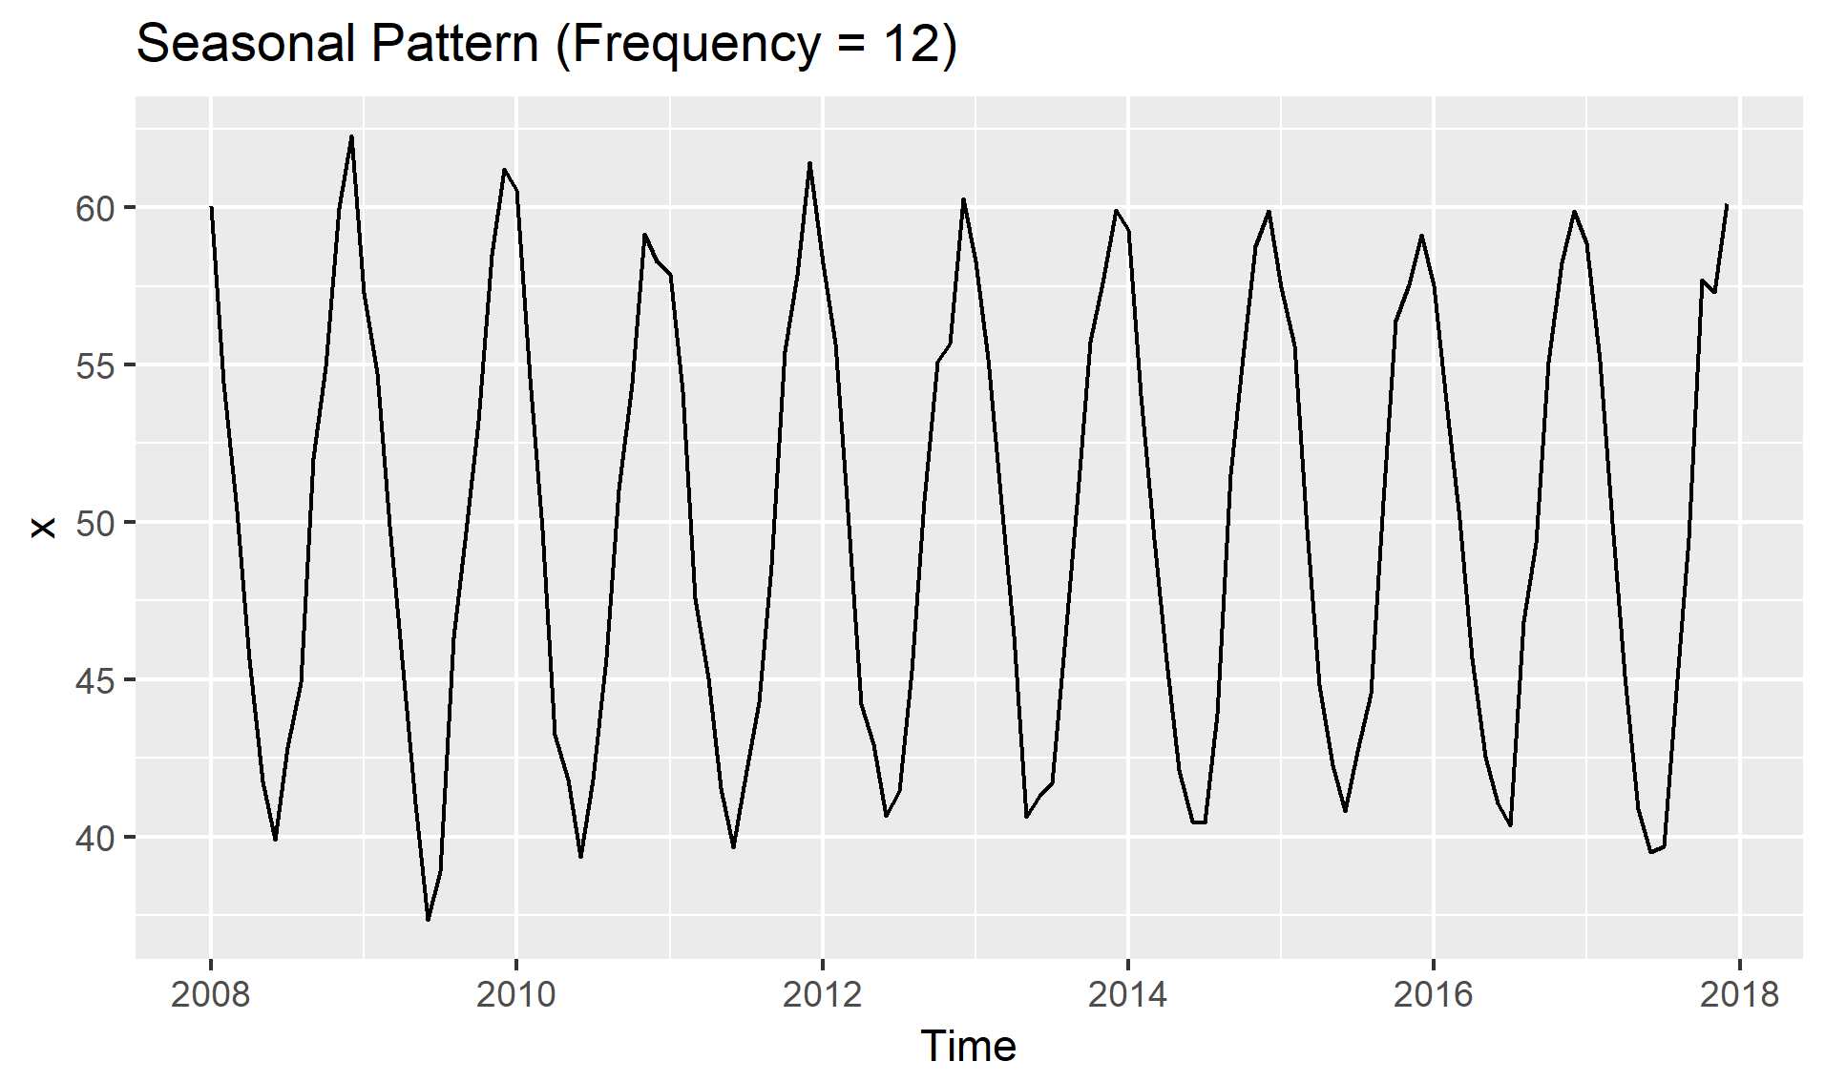
Seasonality

Slide 7
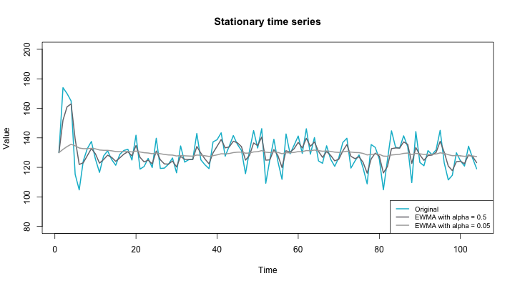
Stationarity

Slide 8


How to test for Stationarity
Augmented Dickey Fuller Test

Slide 9
Making a Time Series Stationary
Differencing – To get rid of varying mean
Transformations – To get rid of non constant variance
Log Transformations
Square Root

Slide 10
Decomposing a Time Series
Level
Trend
Seasonality
Randomness

Slide 11
ARIMA
AR- AutoRegressive
I-Integrated
MA-Moving Average

